Slide 1
CS 3354 Project:
Eruces
A Banking Application
By Jonah Getz, Daniel Jun, Yongming Mai, Jun Ren, Shivani Pattni, Jason Ta, and Grace Zhou

Slide 2
Objective
Make a good banking application
Simple
Easy to use
Incorporate AI

Slide 3
Functional and Nonfunctional Requirements
Functional
Authenticate users
Deposit, withdraw, transfer money
Summarize account info
Customer support
Nonfunctional
Simple UI
High uptime
Protect user data

Slide 4
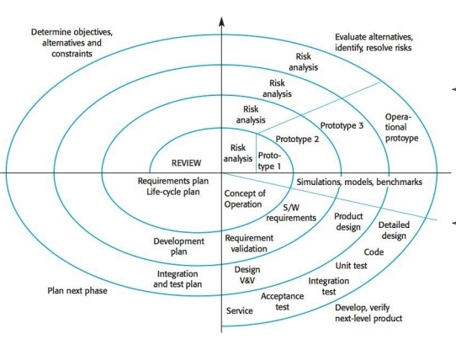
Software Process Model: Spiral Model
Flexibility
- Changing environments and requirements
Transparency
- Continuous communication
Quality assurance
-Identifying and correcting potential defects timely
Iterative Development:
-Quick feedback and adjustments
From Dr. Ebru Cankaya Lecture

Slide 5
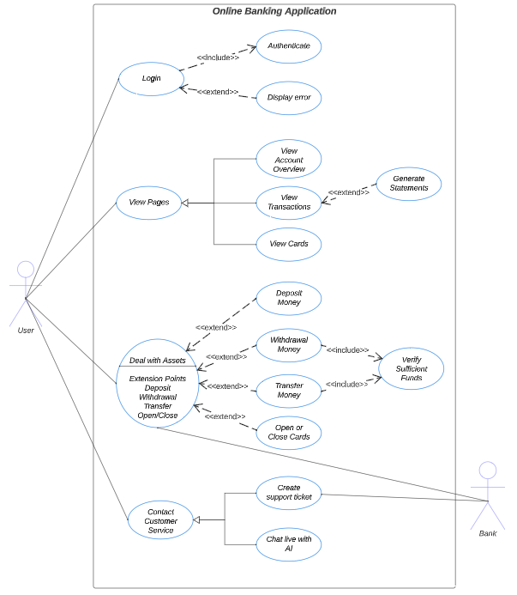
Use Case Diagram
Login
Authentication
View Pages
Account Overview
View Transactions
View Cards
Deal with Assets
Deposit Money
Withdraw Money
Transfer Money
Open/Close Cards
Contact Customer Service
Create Support Ticket
Live Chat with AI

Slide 6
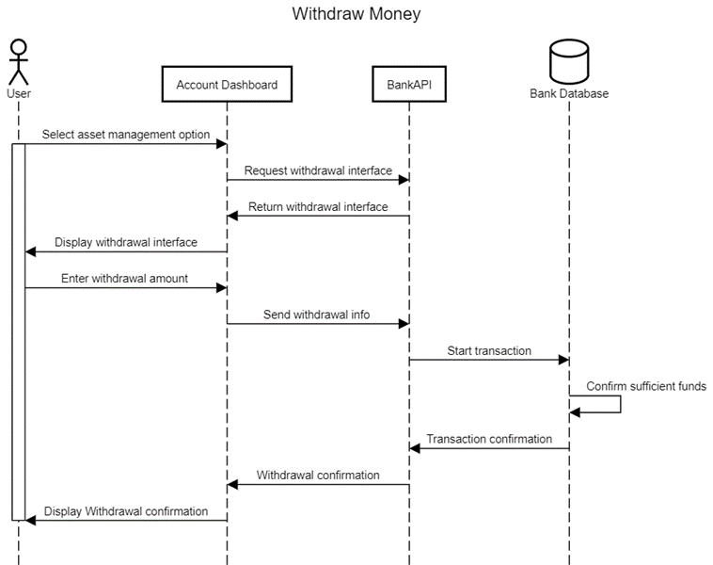
Sequence Diagram -
single representative operation

Slide 7
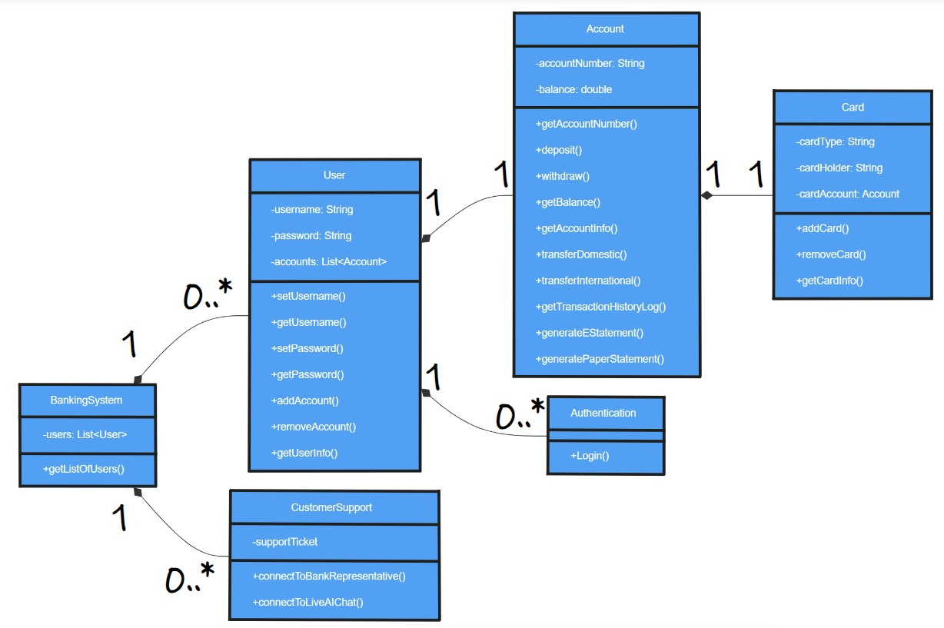
Class Diagram

Slide 8
Architectural Design
The Eruces online banking application will use the Model View Controller (MVC) architectural system. This system has been chosen because of several advantages that it offers:
Wide adoption: MVC has been an industry standard for years in the development of web applications, and is thus well documented and with mature specifications
Existing tools: tools such as Microsoft’s ASP.NET MVC Pattern can speed development of MVC applications.
Flexibility of Data Representation: because of the separation between data and views in MVC, the representation of customer data can be changed independently of the actual data. Also allows for platform flexibility, such as an app vs. desktop browser based application.
Requirements Flexibility: MVC allows a high degree of change in application requirements, which fits the Spiral development model used by Eruces. The architectural design can easily accommodate any feedback in each iteration.

Slide 9
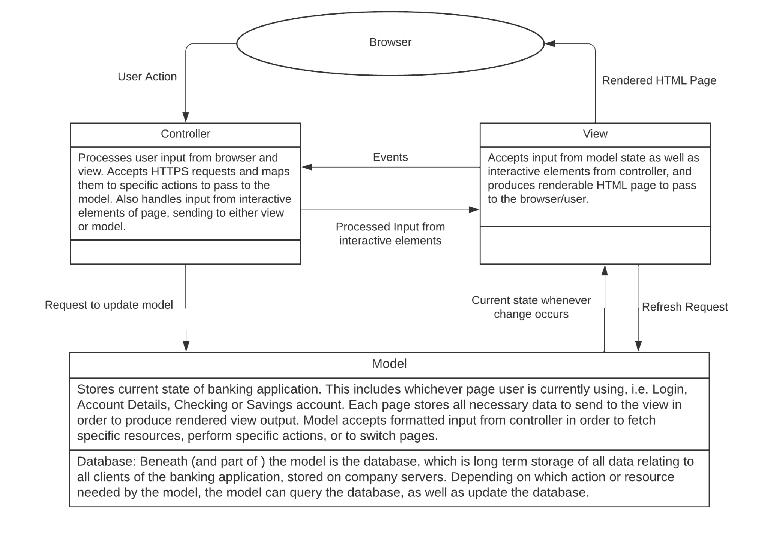
Architectural Design Diagram

Slide 10
Project Scheduling
Start Date: December 1, 2023
End Date: August 31, 2024
Total Duration: 9 months
Based on our Function Point Analysis and the complexity of an online banking application, this should allow enough time to complete proper testing and feedback as well as a buffer for unexpected delays that may arise during the process.

Slide 11
Estimated Cost of Hardware Products
Server
Security is the first priority for a banking system
So we will favor physical server rather than cloud-based servers
Cost for a typical physical server is $1,476.31
More servers will be added as the project scope expands

Slide 12
Estimated Cost of Software Products
Authentication (optional): using Duo Security
Price: $6 per user per month = $72 per user per year
Estimating approximately 5000 users for the app at launch
~$360000 per year on authentication
LLM API for AI customer service: using GPT-4
Price: $0.01 per 1000 tokens. 1000 tokens is about 750 words or one page of text [2]
Estimating that each AI customer support ticket will use on average 750 tokens
With about 5000 users, every day about one percent will have an issue.
5000 * 0.01 = 50 per day
50 * 0.01 * (750 / 1000) = $0.375 per day, or ~$140 per year on LLM API

Slide 13
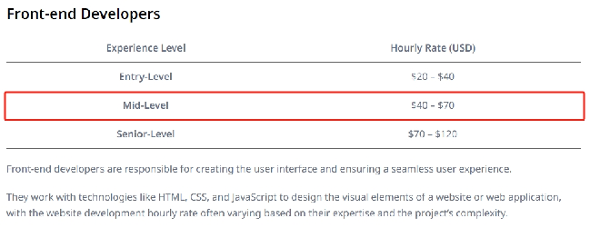
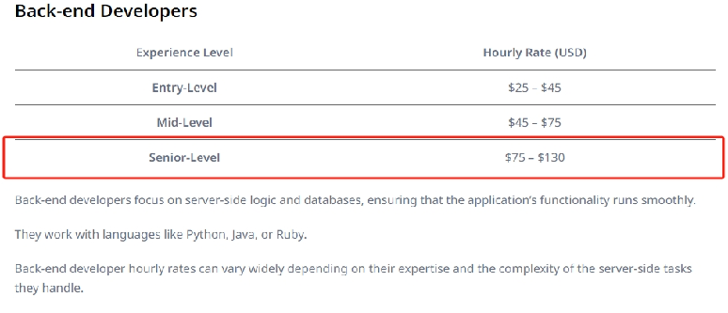
Front-end Developers: 2 Mid-Level ($40 - $70 per hour)
adequate skills for user interface and user experience tasks
-offering a balance
-cost-effectiveness.
Back-end Developers: 2 Senior-Level ($75 - $130 per hour)
need highly experienced developers capable of handling complex business logic and data processing in banking software.
-Stability
-Security

Slide 14
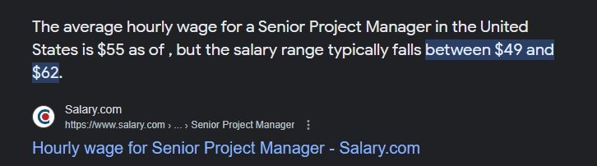
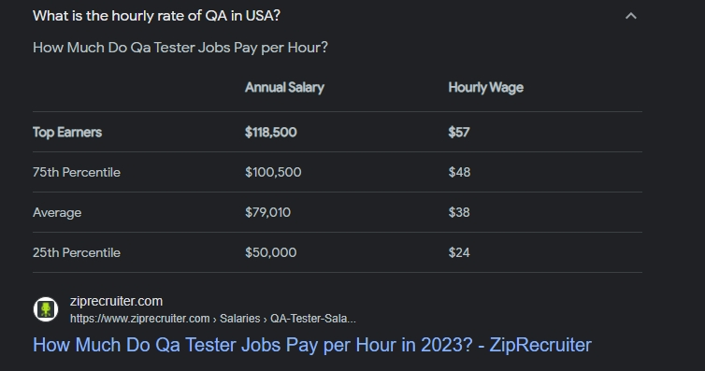
Project Manager: 1 Senior-Level ($49 - $62 per hour)
Vital for ensuring the project is completed on time and within budget.
-extensive experience helps in managing the team
-coordinating resources
Quality Assurance Engineers: 2 Mid-Level ($48 - $57 per hour)
-Sufficient experience to identify and resolve issues

Slide 15
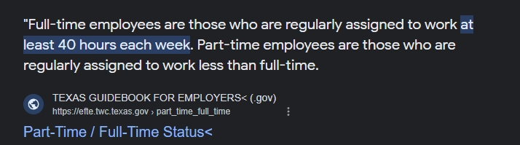
Cost Calculation:
Front-end Developers: 2 x $55 (average) x 40 hours = $4,400
Back-end Developers: 2 x $102.5 (average) x 40 hours = $8,200
QA Engineers: 2 x $52.5 (average) x 40 hours = $4,200
Project Manager: $55 (average) x 40 hours = $2,200
Total = $4,400 (Front-end) + $8,200 (Back-end) + $4,200 (QA) + $2200 (PM) = $19,000
Given the intuitive nature of the banking software:
-Don’t need many people( estimate 20)
-All cost(material and people) ≈ 200
Total after installation: 20 x $200 = $4000
$19,000 + $4000 = $23,000

Slide 16
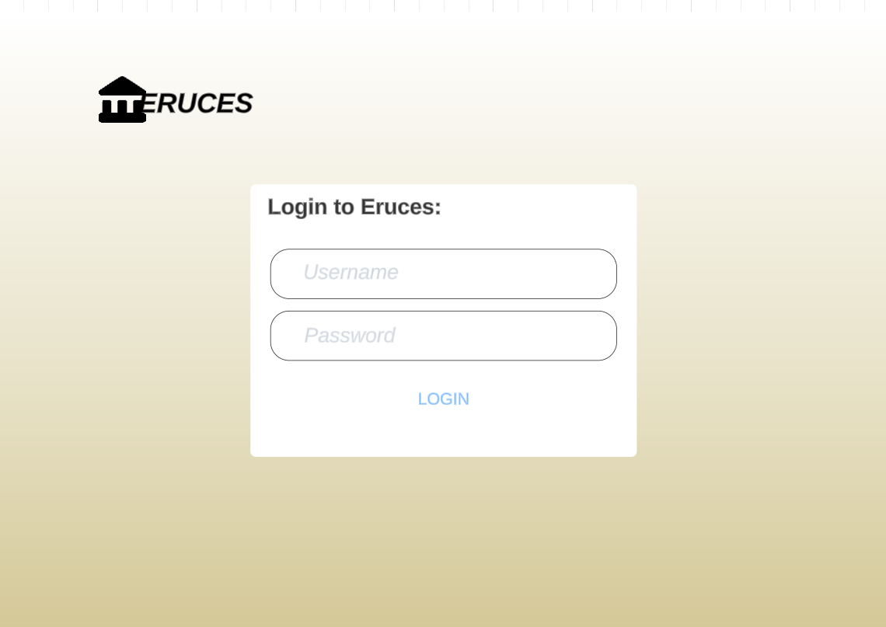
User Interface: Login

Slide 17
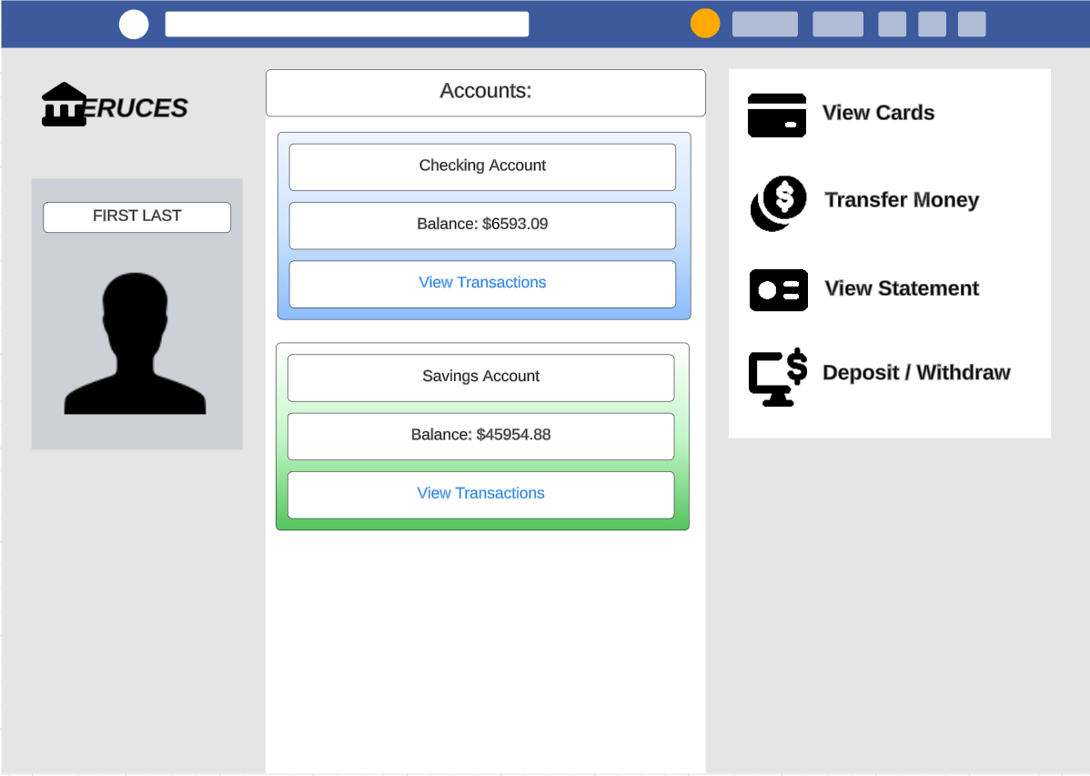
User Interface: Accounts

Slide 18
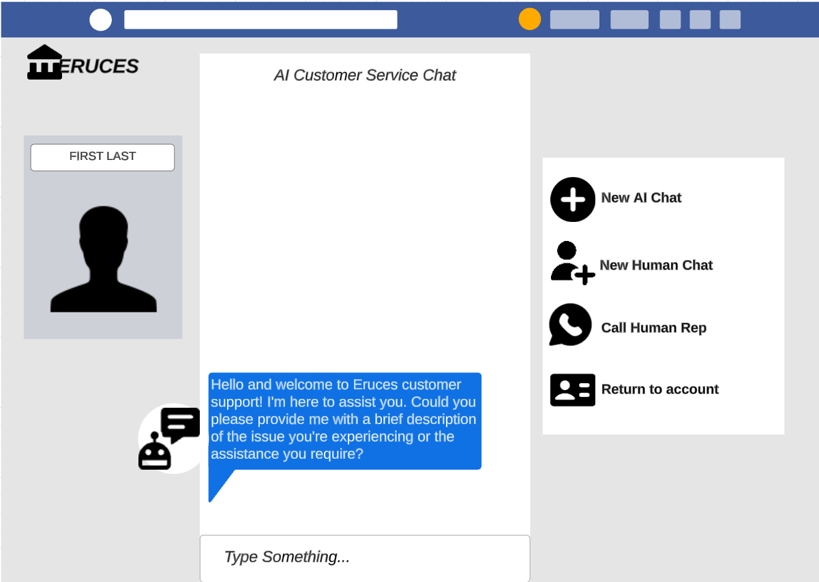
User Interface: AI Chat

